Slide 1
BB8PJ Senior Section Self-Paced Awards
2021

Slide 2
Seniors Awards

Slide 3
Welcome Seniors to 2020
Step 1:
Read through your BB Handbook to identify which badges you are keen on taking this year. If time and resource permits, your officers will work together with you to define the relevant requirements.
Step 2:
Once selected, ensure you keep your officers updated on the progress of your report and set up mid-point cadence (or as frequent as required) to ensure you are on the right track.
Step 3:
Complete all requirements set up and earn your badge! Download your awards form on PDF version and obtain your officer’s signature
Self-paced awards list for 2021 is available on the next page. However, if you are keen on any other badges, ensure you communicate it to your officers
When in doubt, make sure you put in the necessary efforts to find the answer. If still in doubt, don’t feel scared or shy to approach your officers

Slide 4
List of Self-Paced Awards
Arts
Hobbies
Crafts
Environmental Conservation
Christian Education
International Relations (Partial)
Keen on taking your Founder’s and President’s Award?
Do inform you officer before hand
Kindly ensure you read through your BB Handbook in detail and the requirement links above before approach your officers

Slide 5
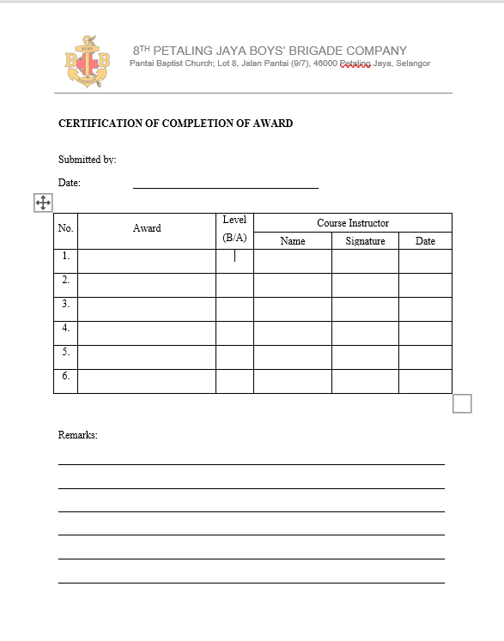
List of Self-Paced Awards
Award | Requirements Speak to Lt. Yvonne if your requirements are not available
Arts *Lt. Yvonne
Crafts *Lt. Yvonne
Hobbies *Lt. Yvonne
Environmental Conservation *Lt. Yvonne
Christian Education *Lt. Sherwin
International Relations *Lt. Yvonne
Awards Form Link Available Here
For advanced, speak with your officer to find out more

