Slide 1
FIRE & RESCUE
WEEK 4
Boys’ Brigade 8th Petaling Jaya Fire & Rescue- Basic

Slide 2
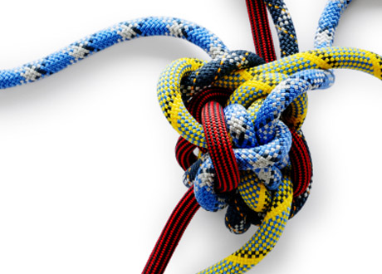
Week 4- Knots
Bowline Knot
Clove Hitch
Fire of eight on bight(double figure of eight)
Half Hitch & Round turn two half hitches
Becket/sheet bend
Overhand Safety Knot
Water Knot
Boys’ Brigade 8th Petaling Jaya Fire & Rescue- Basic

Slide 3
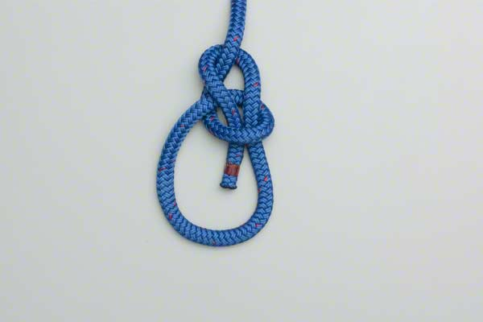
Bowline
It is a fixed loop tied at the end of a rope to attach the rope to something.
It does not slip or become loose; can be quickly and easily untied
Can also be used in rescue situations (around waist or etc) because it’s a fixed loop
https://www.animatedknots.com/bowline/index.php
Boys’ Brigade 8th Petaling Jaya Fire & Rescue- Basic

Slide 4
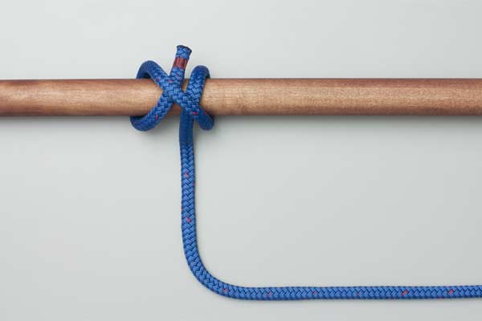
Clove Hitch
Used to secure rope to a pole.
Often used to secure tent poles.
Would not be secure if strain is not from a constant angle.
https://www.animatedknots.com/cloveend/index.php
Boys’ Brigade 8th Petaling Jaya Fire & Rescue- Basic

Slide 5
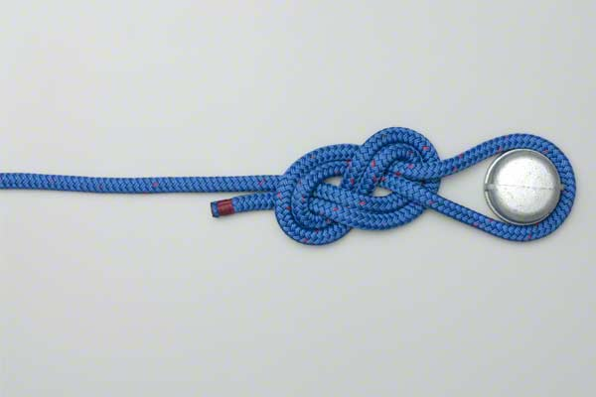
Double figure of Eight
Used as an achor knot, usually used in climbing by attaching the harness to the rope.
https://www.animatedknots.com/fig8follow/index.php
Boys’ Brigade 8th Petaling Jaya Fire & Rescue- Basic

Slide 6
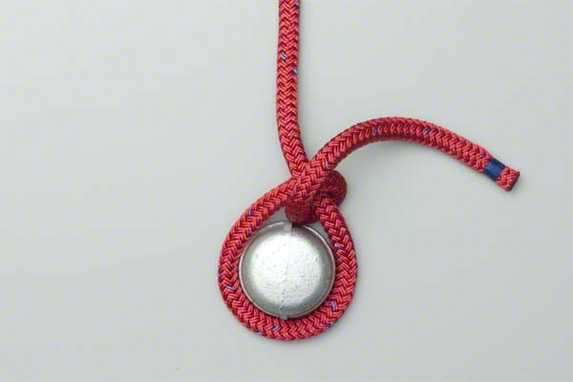
Half Hitch
Secure rope to something
Round turn two half hitches is more secure >
https://www.animatedknots.com/halfhitch/index.php
Boys’ Brigade 8th Petaling Jaya Fire & Rescue- Basic

Slide 7
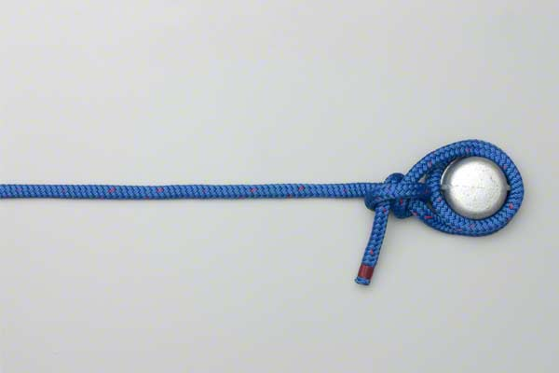
Round turn two half hitches
Strong and dependable knot which never jams
Can be used to fasten to a ring, hook, handle, pole, beam.
https://www.animatedknots.com/roundturn/index.php
Boys’ Brigade 8th Petaling Jaya Fire & Rescue- Basic

Slide 8
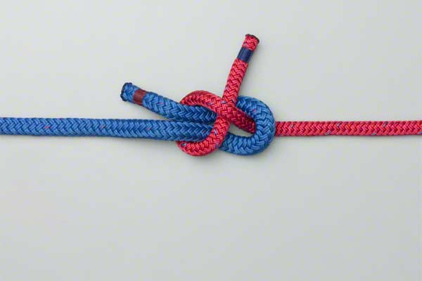
Sheet Bend
Used to join two ropes of different diameters.
Not to be used under circumstances where it is subjected to great pressure because not 100% secure.
https://www.animatedknots.com/sheetbend/index.php
Boys’ Brigade 8th Petaling Jaya Fire & Rescue- Basic

Slide 9
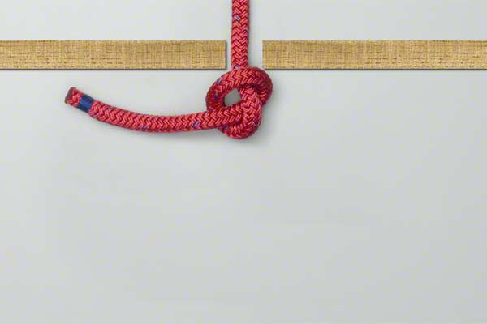
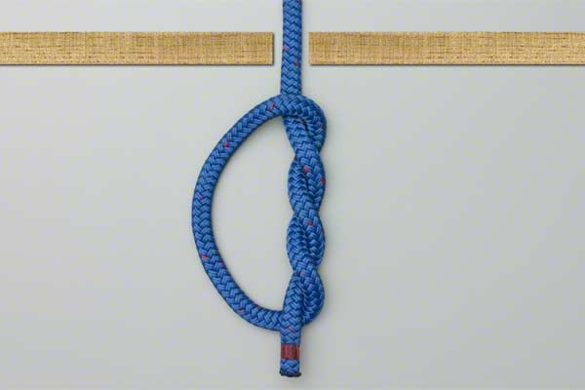
Overhand safety knot
Used as as stopper knot but figure of 8/ double overhand knot is safer.
https://www.animatedknots.com/overhand/index.php
https://www.animatedknots.com/doubleoverhand/index.php
Boys’ Brigade 8th Petaling Jaya Fire & Rescue- Basic

Slide 10
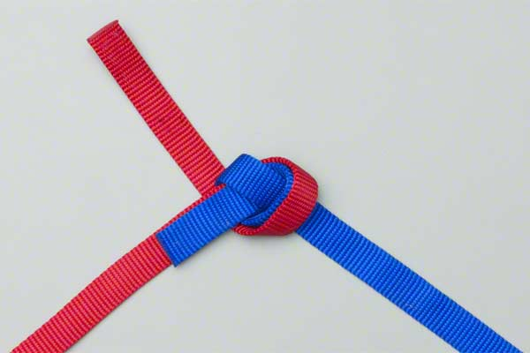
Water knot
In climbing it is used to join two pieces of webbing strapping.
https://www.animatedknots.com/waterknot/index.php
Boys’ Brigade 8th Petaling Jaya Fire & Rescue- Basic

Slide 11
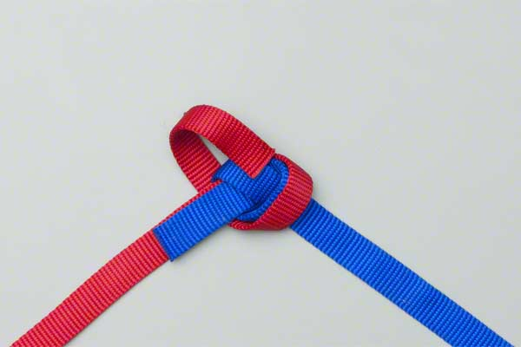
Water knot
Boys’ Brigade 8th Petaling Jaya Fire & Rescue- Basic

Slide 12
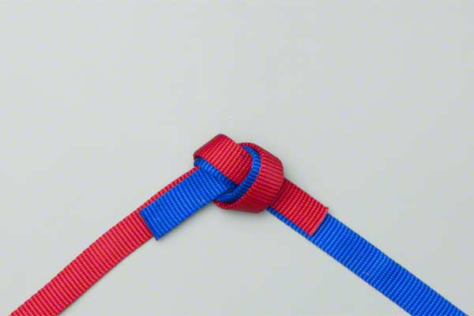
Water knot
Boys’ Brigade 8th Petaling Jaya Fire & Rescue- Basic

Slide 13
Water knot
Boys’ Brigade 8th Petaling Jaya Fire & Rescue- Basic

