Slide 1
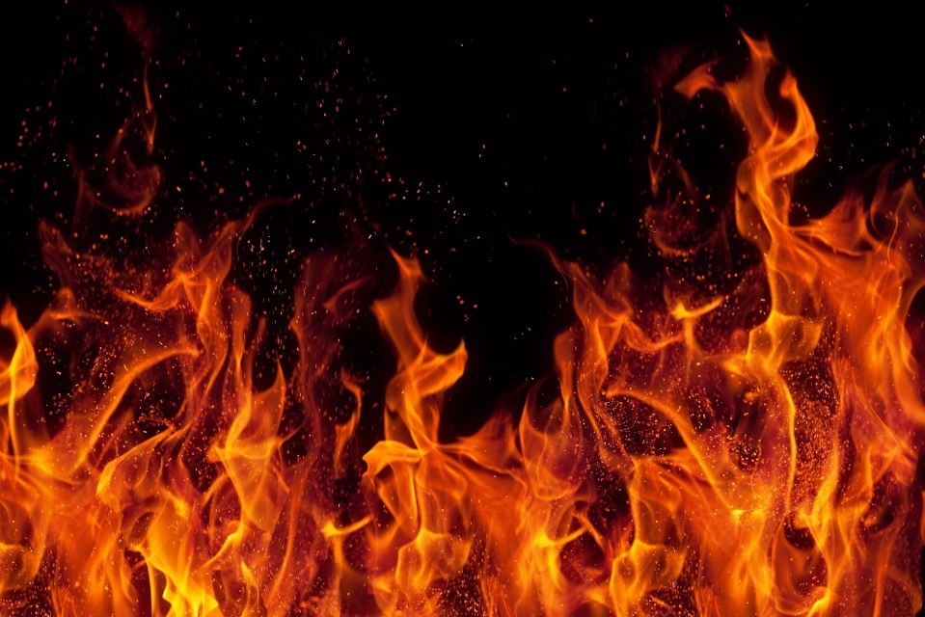
Week 1- Science of Fire
A process in which substances combine chemically with oxygen from the air and typically give out bright light, heat, and smoke; combustion or burning.
Inhaled air : 21% Oxygen ; 0.04% Carbon Dioxide ; 79% Nitrogen
Exhaled air : 16% to 17% Oxygen; 4% to 5% Carbon Dioxide; 79% Nitrogen
Fire need only: 16% Oxygen
Boys’ Brigade 8th Petaling Jaya Fire & Rescue- Basic

Slide 2
Personal Safety
Knowledge Is Power Use It Wisely
Emergency contacts
Basic first aid knowledge
Common sense
Remain calm & DO NOT PANIC
Additional reads: https://bit.ly/2LErAAg
Boys’ Brigade 8th Petaling Jaya Fire & Rescue- Basic

Slide 3
Objective(s)
Cause(s) of fire
Dangers of fire
Types of fire
Boys’ Brigade 8th Petaling Jaya Fire & Rescue- Basic

Slide 4
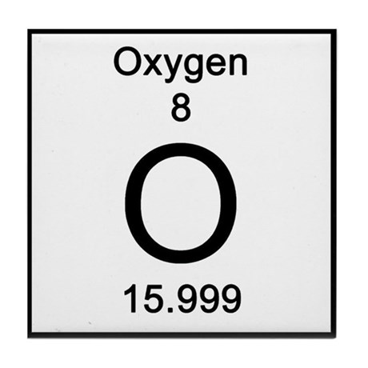
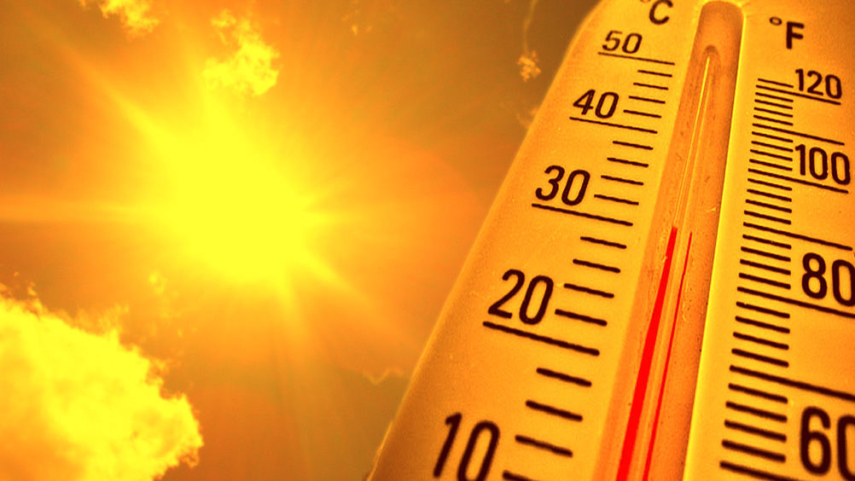
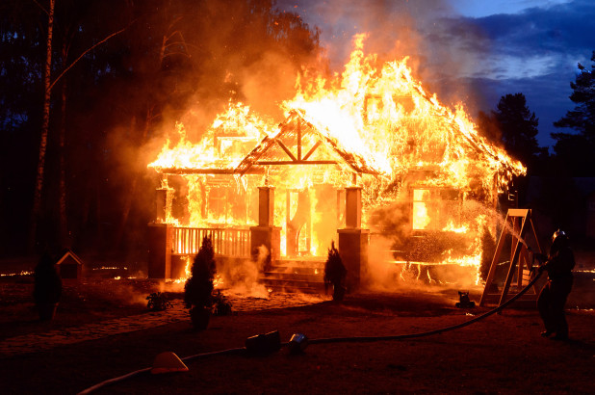
Cause(s) of fire
Fire requires 3 elements to exist;-
Fuel
Heat
Oxygen
Boys’ Brigade 8th Petaling Jaya Fire & Rescue- Basic

Slide 5
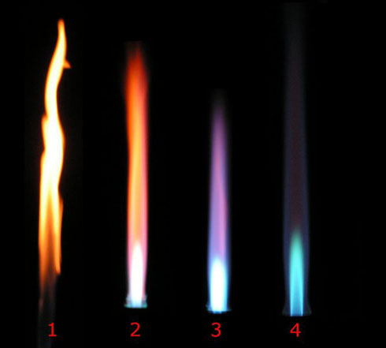
Why seconds matter?!
https://bit.ly/2RqGEa3
Red Flame: 500-800 Deg C
Orange: 1000 - 1200 Deg C
White: 1300-1500 Deg C
Blue: 1400-1650 Deg C
Boys’ Brigade 8th Petaling Jaya Fire & Rescue- Basic

Slide 6
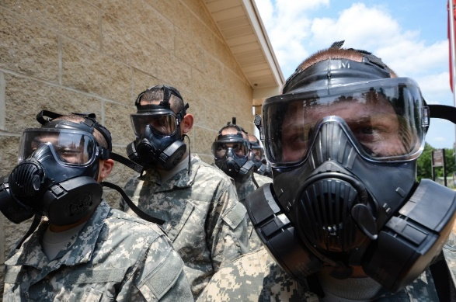
Dangers of fire
The fire kills or the fumes kills?
A majority of fire deaths are not caused by burns but by inhalation of chemical fumes
When oxygen levels are at... | ...a person experiences:
21 percent | Normal outside air
16 percent | Impaired judgment and coordination
12 percent | Headache, dizziness, nausea, fatigue
9 percent | Unconsciousness
6 percent | Respiratory arrest, cardiac arrest, death
Toxic gases that are most common are:-
Carbon monoxide
Hydrogen cyanide (found in burning plastics)
Phosgene
Boys’ Brigade 8th Petaling Jaya Fire & Rescue- Basic

Slide 7
What to do?
https://bit.ly/2EZPMN8
Boys’ Brigade 8th Petaling Jaya Fire & Rescue- Basic

Slide 8
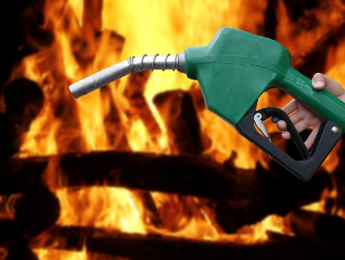
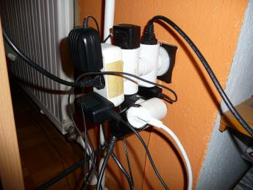
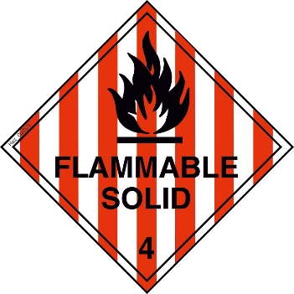
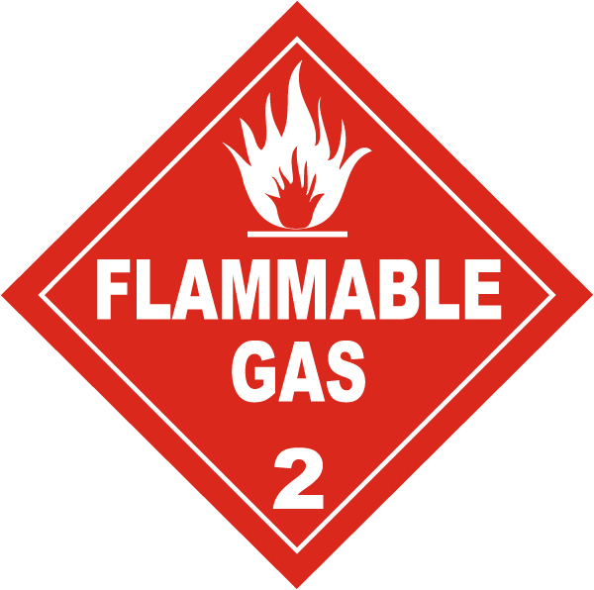
Types of fire
Class A: These are fires involving flammable solids, e.g. wood, cloth, rubber, paper, and some types of plastics. An example of this type of fire would be a campsite fire.
Class B: These are fires involving flammable liquids or liquefiable solids, e.g. petrol, oil, paint and also some waxes & plastics, but not cooking fats or oils.
Class C: These are fires involving flammable gases, e.g. natural gas, hydrogen, propane, butane.
Class D: These are fires involving combustible metals, e.g. sodium, magnesium, and potassium.
Class E: These are fires involving any of the materials found in Class A and B fires, but including electrical appliances, wiring, or other electrically energized objects in the vicinity of the fire, with a resultant electrical shock risk if a conductive agent is used to control the fire.
Class F: These are fires involving cooking fats and oils. The high temperature of these types of fats and oil when on fire far exceeds that of other flammable liquids which means that normal fire extinguishers should not be used.
Boys’ Brigade 8th Petaling Jaya Fire & Rescue- Basic

Slide 9
BONUS MARKS
https://bit.ly/2LFyl4L
https://bit.ly/2LKnl6w
Additional reads: https://bit.ly/1FQQOFw
Boys’ Brigade 8th Petaling Jaya Fire & Rescue- Basic

