Slide 1
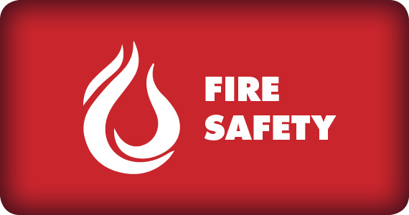
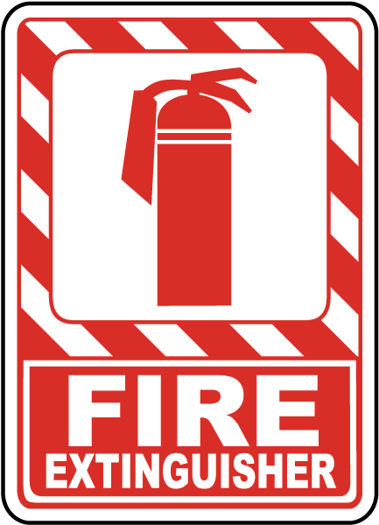
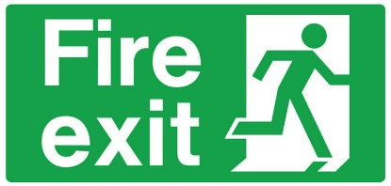
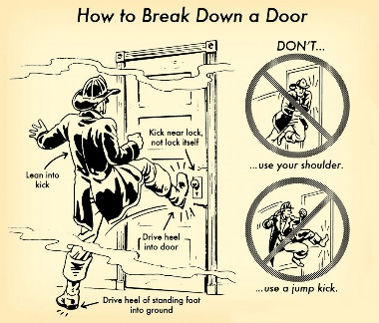
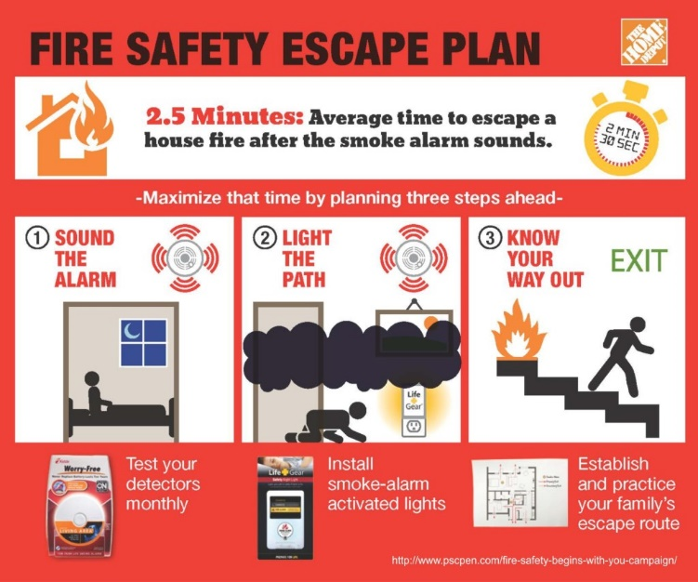
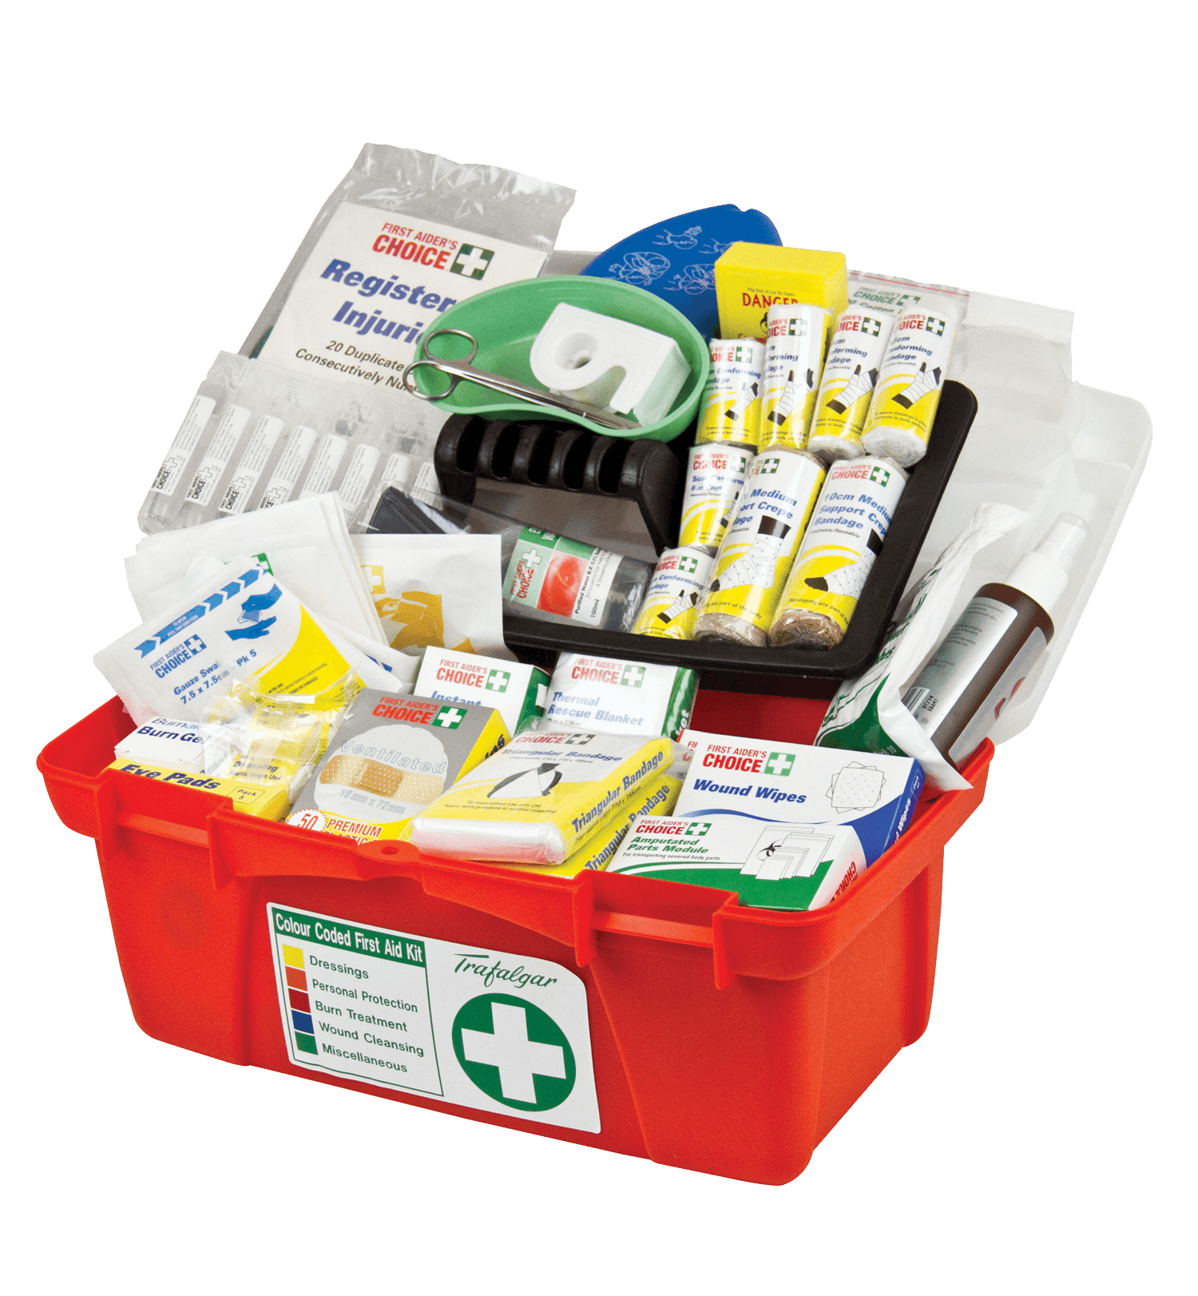
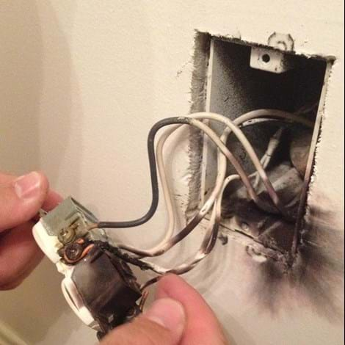
Week 2- Fire Safety
Boys’ Brigade 8th Petaling Jaya Fire & Rescue- Basic

Slide 2
Objective(s)
Fire Extinguisher Types
Handling Fire Extinguishers
Fire Blankets
Fire Safety In Public
Fire Safety Planning At Home
First-Aid applications
Boys’ Brigade 8th Petaling Jaya Fire & Rescue- Basic

Slide 3
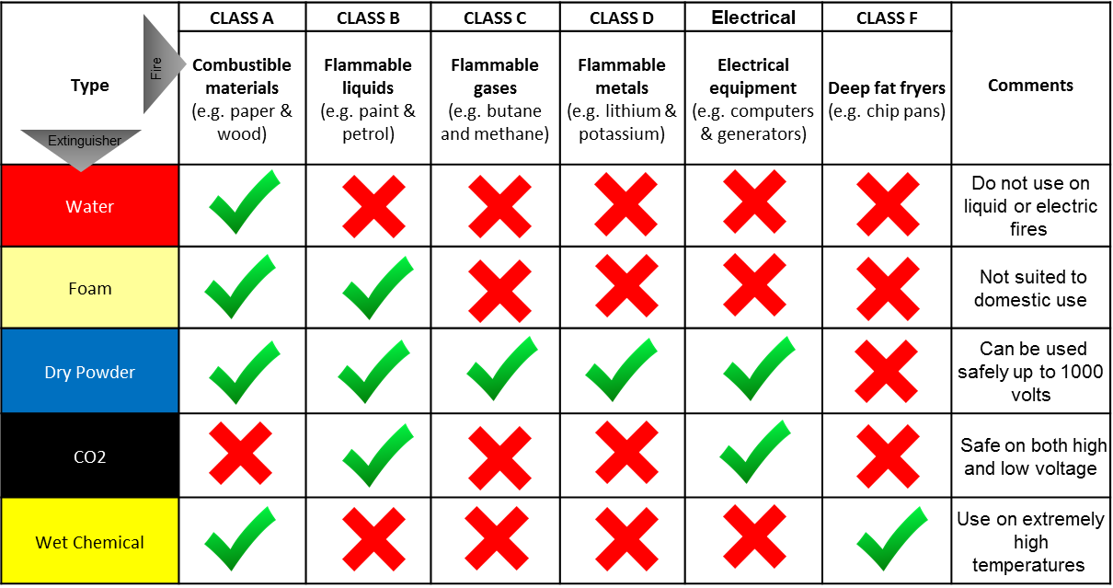
Fire Extinguisher Types
Boys’ Brigade 8th Petaling Jaya Fire & Rescue- Basic

Slide 4
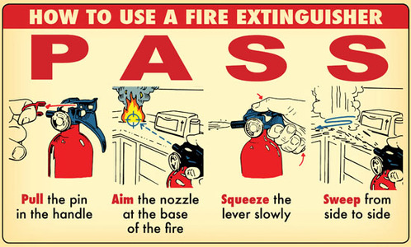
P.A.S.S
Pull the pin to unlock the operating lever to discharge the extinguisher
Aim low with the fire extinguisher at the base of fire
Squeeze the lever above the handle – releasing the lever will stop discharge
Sweep from side to side while moving carefully toward the fire until the flames appear to be out. Watch the fire area. If the fire re-ignites, repeat the process.
https://bit.ly/1DFUgeT
Additional reads: https://bit.ly/2GXB3nQ
Boys’ Brigade 8th Petaling Jaya Fire & Rescue- Basic

Slide 5
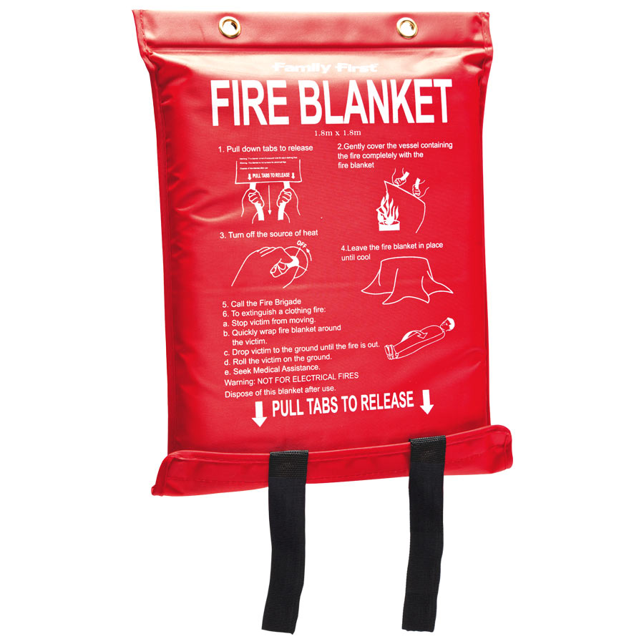
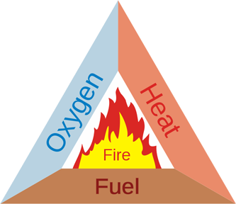
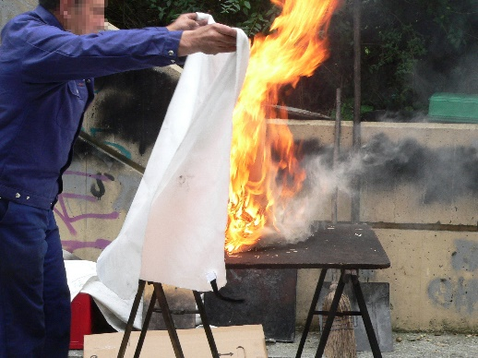
Fire Blankets
What are fire blankets?
Fire-resistant sheets of material that you can use to cover a fire to cut its supply of oxygen or wrap around a person whose clothes are on fire. You can also only use them on very small and contained fires (like fat-pan fires on the cooker)
Fire Blanket Maintenance
Once used you must dispose of it and replace with a new fire blanket.
https://bit.ly/2QfpozN
Additional reads: https://bit.ly/2ENCOPK
Boys’ Brigade 8th Petaling Jaya Fire & Rescue- Basic

Slide 6
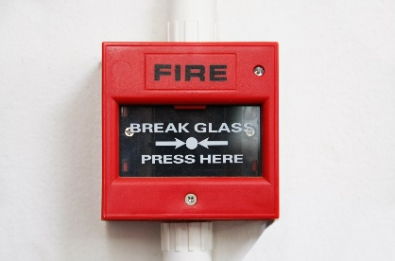
Fire Safety In Public
Over 700 high-risk buildings in Kuala Lumpur – Shopping malls, hotels & factories.
First sign of warning will be hearing the smoke alarms/ fire bell. Possible sprinklers kick into action.
Remain calm and collected as best as possible.
Look for Emergency Exits
If suspected fire in public,
Smoke Detector: https://bit.ly/2s20mdO
Fire Bell Alarm: https://bit.ly/2LJnBSV
Boys’ Brigade 8th Petaling Jaya Fire & Rescue- Basic

Slide 7
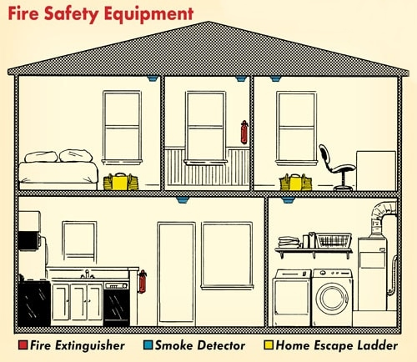
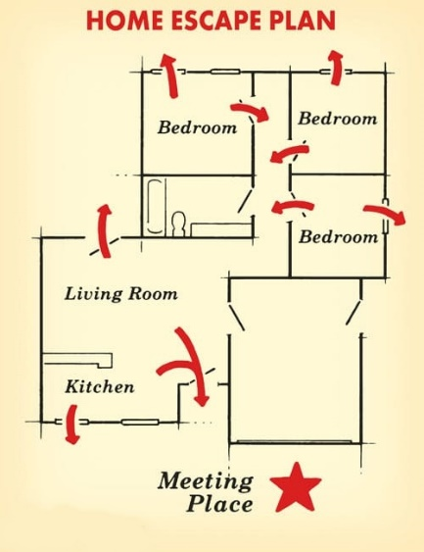
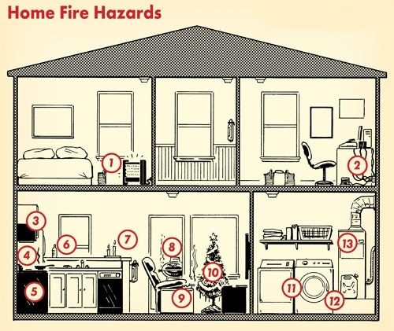
Fire Safety At Home
Heroics don’t start with fire fighters, they start at home with you!
Do you have fire extinguishers/ fire blankets/ smoke detectors at home?
Fire escape plan?
Electrical safety?
Additional reads: https://bit.ly/2LyccYC
Boys’ Brigade 8th Petaling Jaya Fire & Rescue- Basic

Slide 8
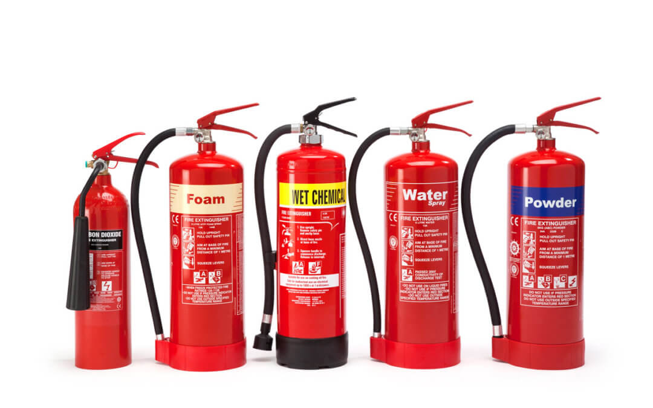
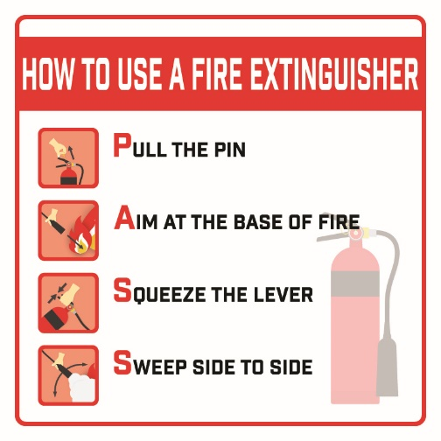
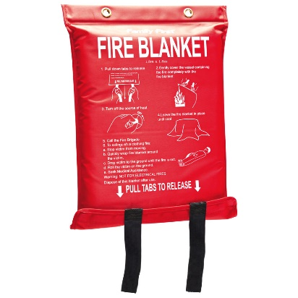
Fire Extinguishers / Fire Blankets
Place at the highest probability of a fire – Kitchen, garage/workshop, laundry room, bedrooms & grill.
Placed at a location easily accessible at a maximum of 5 feet from the ground Have at least 1 fire extinguisher on every level of your home.
Identify whether the fire is manageable to be extinguish.
Boys’ Brigade 8th Petaling Jaya Fire & Rescue- Basic

Slide 9
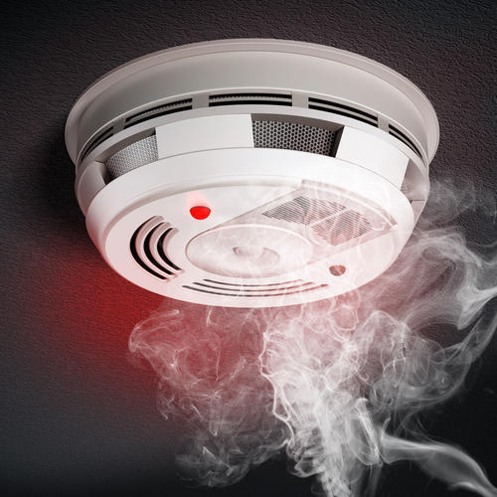
Smoke Detectors
Two-thirds of all fire deaths occur in homes with either no working smoke alarm or no alarm period.
Make sure there are 1 smoke alarm installed in every bedroom, outside every sleeping area & every floor.
Test your alarm monthly by hitting the “test” button.
Ensure your alarm works at all times.
Boys’ Brigade 8th Petaling Jaya Fire & Rescue- Basic

Slide 10
Fire Escape Plan
The goal is to reach outside as fast as possible with the least amount of effort required.
Inspect all possible exits and escape routes together with everyone in your household to plan together.
Choose an outside meeting place within a safe distance from the house to rendezvous together.
Be specific with your details to the emergency operator.
Remain outside until Firefighters has declared that it is safe.
Boys’ Brigade 8th Petaling Jaya Fire & Rescue- Basic

Slide 11
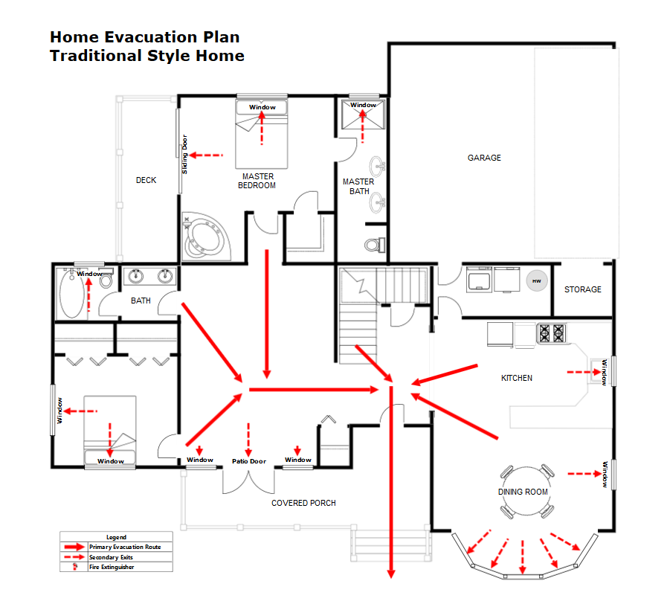
Optional Assignment (2 marks)
Sketch a detailed plan of your ‘Fire Escape’ with the route to be taken from your house with the least amount of time.
State the procedure needed for your plan to succeed.
Specify the total time required from your house to the ‘Safe Zone’.
Due date submit is before the end of the course.
Additional reads: https://bit.ly/2DcEUHS
Boys’ Brigade 8th Petaling Jaya Fire & Rescue- Basic

Slide 12
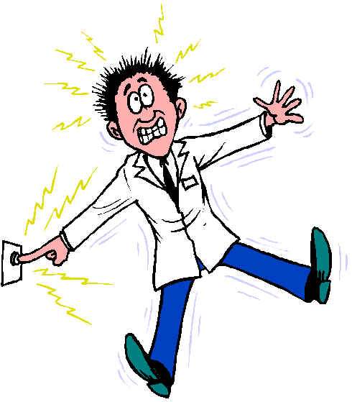
Electrical Safety
Check all cords, plugs, surge protectors and extension cords for frayed casing, exposed wire – Replace immediately.
Never run extension cords under carpets or over door thresholds.
Do not OVERLOAD one outlet with several high-wattage.
Place heat-producing appliances away from flammable or combustible goods
Keep your kitchen exhaust fan clean and free from grease, lint and other obstructions.
Replace any electrical items when outlet sparks appear immediately!
Additional reads: https://bit.ly/2GO4RPK
Boys’ Brigade 8th Petaling Jaya Fire & Rescue- Basic

Slide 13
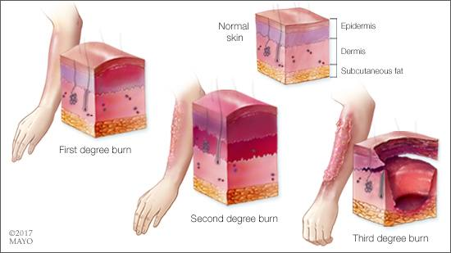
First Aid Applications
First-degree burns damage only the outer layer of skin
Second-degree burns damage the outer layer and the layer underneath
Third-degree burns damage or destroy the deepest layer of skin and tissues underneath
Stop the Burning Process
Remove smoldering clothing
Brush off dry chemicals
Irrigate liquid chemicals
Cool the burn
Hold the burned area under cool (not cold) running water for 10 or 15 minutes or until the pain subsides. If this is impractical, immerse the burn in cool water or cool it with cold compresses. Cooling the burn reduces swelling by conducting heat away from the skin. Don't use ice or ice water. Putting ice directly on a burn can cause further damage to the wound.
Do not remove clothing is the liquid is already cooled off
Clean the wound
Use mild soap and tap water to wash the injury. Gently remove any loose bits of debris in the wound. If blisters are intact, don't break them.
Apply an ointment
Use anesthetic cream, burnt ointment, or aloe gel to soothe the area and prevent dryness.
Cover the burn
Use sterile gauze bandage or clean handkerchief. Don't use fluffy cotton, or other material that may get lint in the wound. Wrap the gauze loosely to avoid putting pressure on burned skin. Bandaging keeps air off the burn, reduces pain and protects blistered skin.
Boys’ Brigade 8th Petaling Jaya Fire & Rescue- Basic

