Slide 1
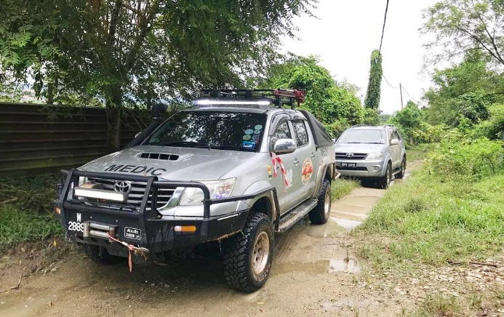
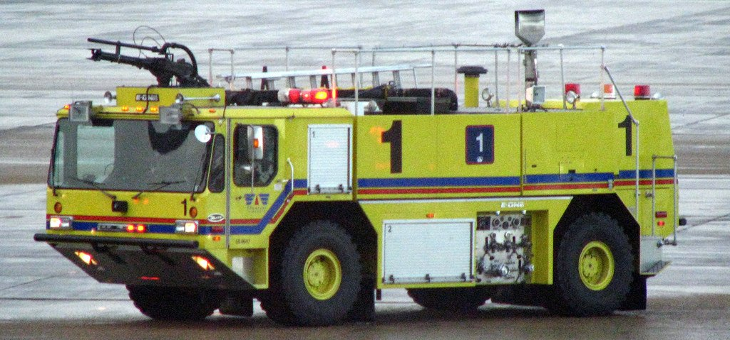
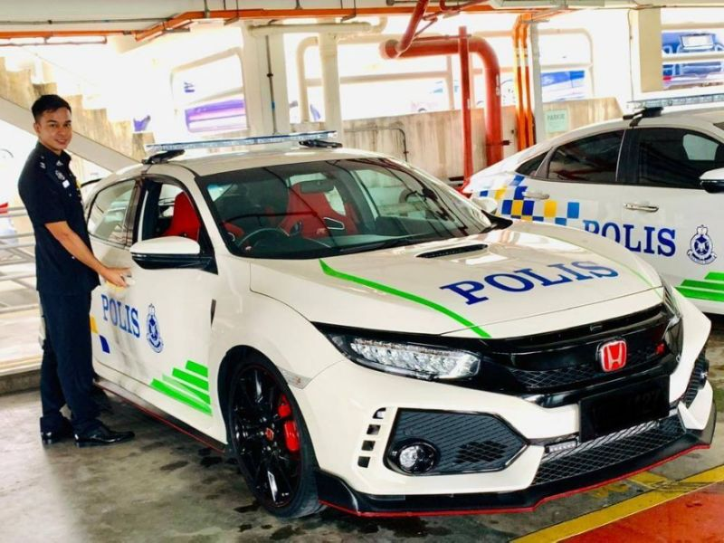
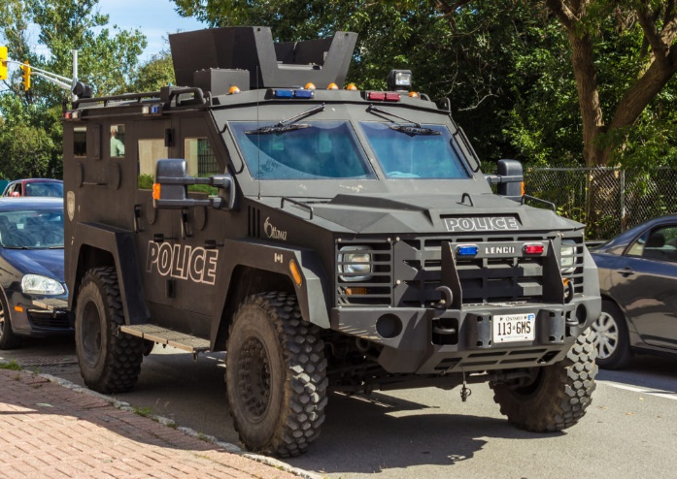
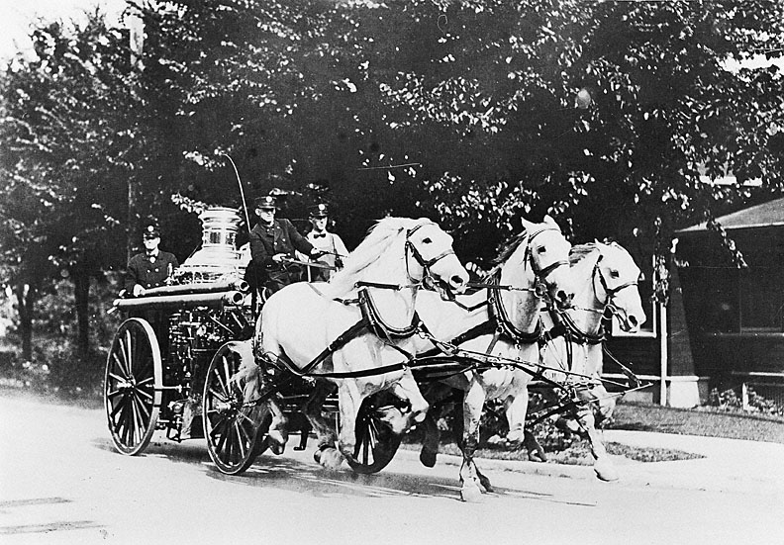
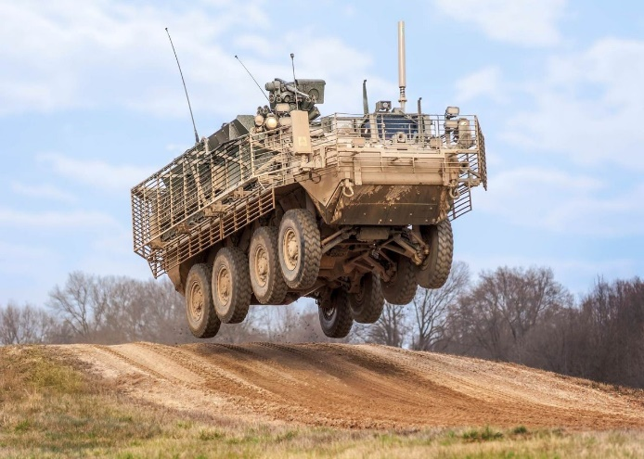
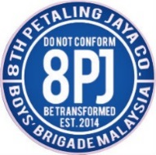
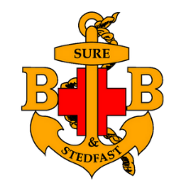
Week 3- Emergency Response Vehicles
Boys’ Brigade 8th Petaling Jaya Fire & Rescue- Basic

Slide 2
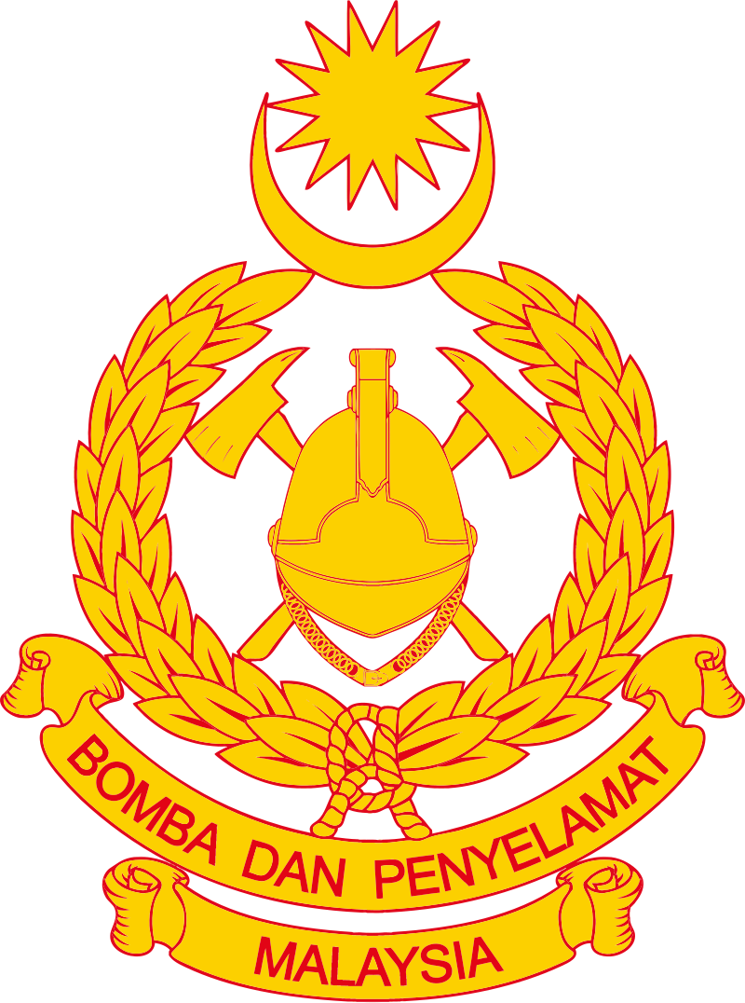
Objective(s)
What are Emergency Response Vehicles (ERV)
History of Fire Engine
Difference Between Types of Engines
Other Emergency Response Vehicles
Boys’ Brigade 8th Petaling Jaya Fire & Rescue- Basic

Slide 3
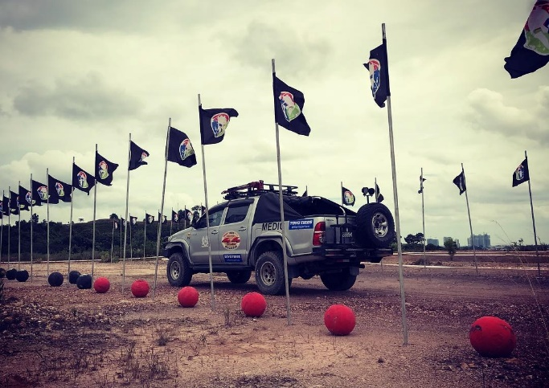
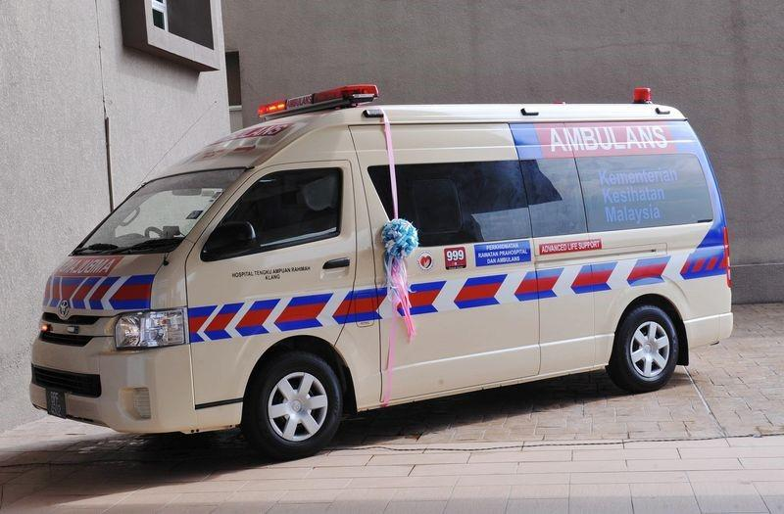
What are ERV?
Designated and authorized to respond to an emergency in a life threatening situation.
Often these vehicles are permitted by law to break conventional road rules to reach the destination as fast as possible.
Mostly operated by different government officials such as Law Enforcement, Fire Department, Emergency Medical Services.
Boys’ Brigade 8th Petaling Jaya Fire & Rescue- Basic

Slide 4
History of Fire Engines
Known as “bucket brigades” as previously at the first stages because citizens were required to leave buckets of water by their doorsteps for use by firefighters in an emergency.
Richard Newsham revolutionized firefighting in 1721 when he filed a patent for the first ever fire engine pump, which could hold 644 litres of water and allowed the bucket brigade to get rid of their puny pails for transporting water.
Though that was not enough as a century later, another invention was introduced so a suction engine that allow firefighters to draw water from a concentrated source
Boys’ Brigade 8th Petaling Jaya Fire & Rescue- Basic

Slide 5
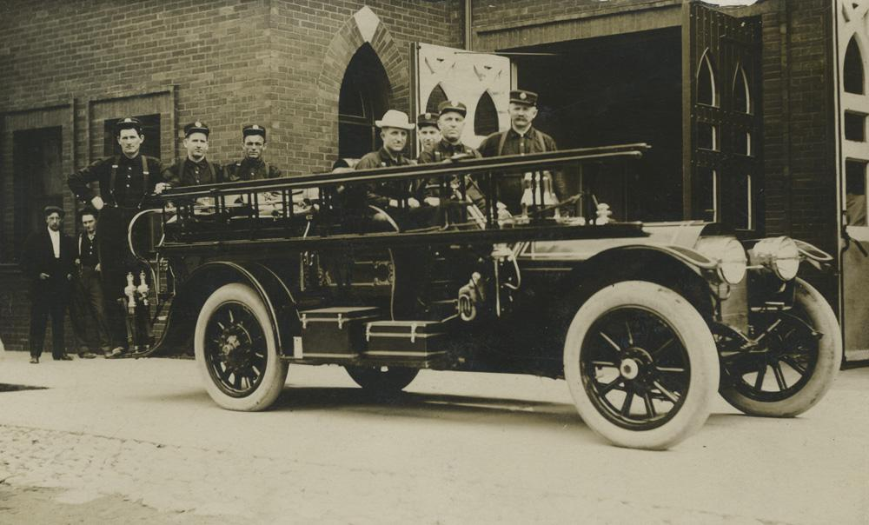
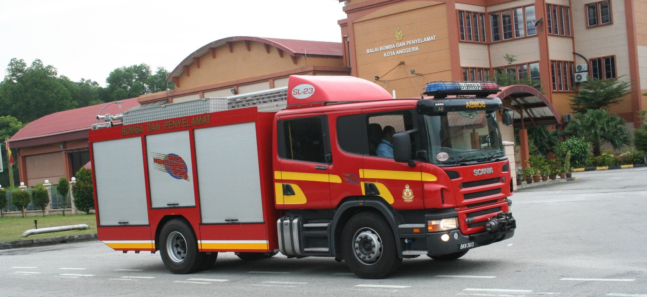
Boys’ Brigade 8th Petaling Jaya Fire & Rescue- Basic

Slide 6
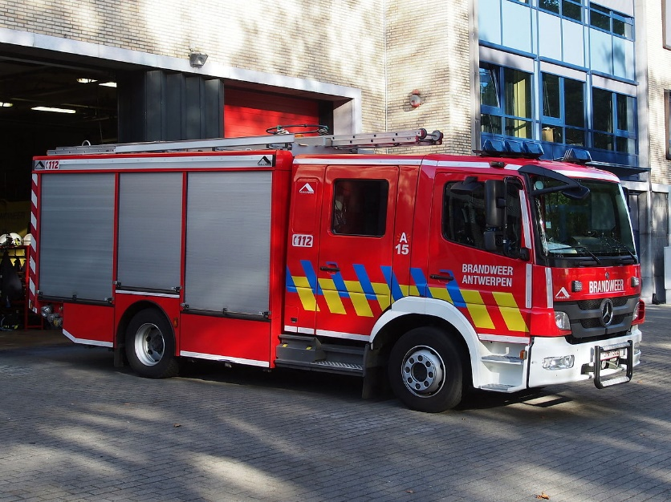
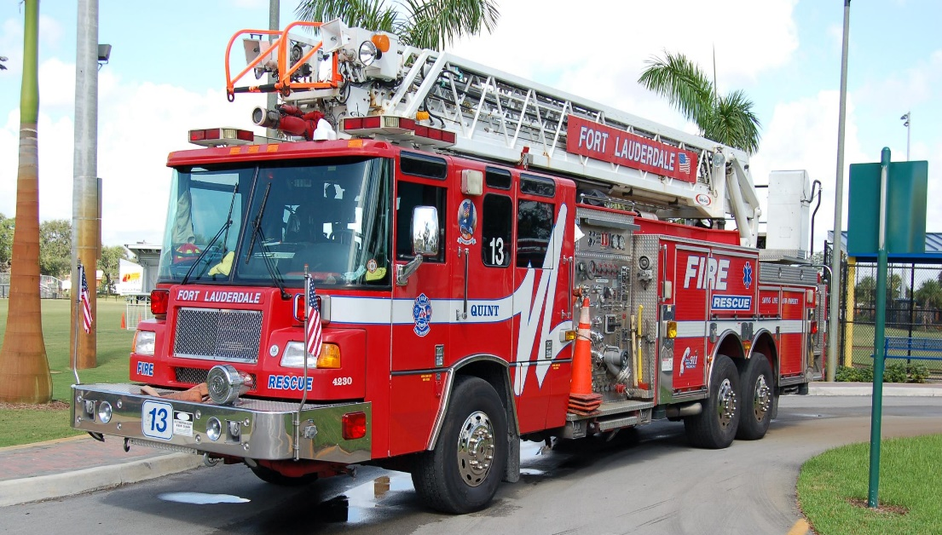
Difference Between Types of Engines
Standard Fire Engine
Designed for primarily transporting firefighters to the scene providing limited water with which to fight the fire, tools, equipment and hoses.
Turntable ladder (TL)
Used for forcible entry, search & rescue operations for high heights using the large telescopic ladder. The term is derived from a large ladder is mounted ona turtable on the back of a truck chassis.
Boys’ Brigade 8th Petaling Jaya Fire & Rescue- Basic

Slide 7
Bonus Marks
Why are fire trucks in red colour?
Boys’ Brigade 8th Petaling Jaya Fire & Rescue- Basic

Slide 8
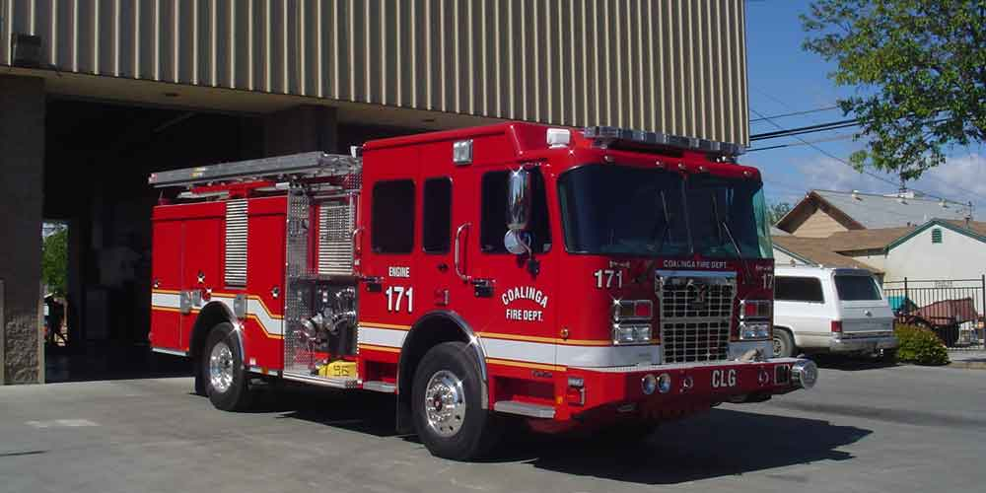
Bonus Marks
Back in 1900, roads were filled with black-colored vehicles. The striking red colour stands out in the crowd.
Psychologically works in modern times. Example such as a school bus is painted in yellow distinctively to be differentiate from the crowd.
Fun fact, back then when fire fighters were volunteers which meant they were unpaid, the colour red was the cheapest paint available back then ☺
Recent studies showed that the human visual system is most sensitive to wavelengths between 510 nm and 570 nm (greenish-yellow) under low-light conditions (Source: https://bit.ly/2Xg0Hbi)
Boys’ Brigade 8th Petaling Jaya Fire & Rescue- Basic

Slide 9
Other Emergency Response Vehicles
Law Enforcement
Emergency Medical Services
Military
Boys’ Brigade 8th Petaling Jaya Fire & Rescue- Basic

Slide 10
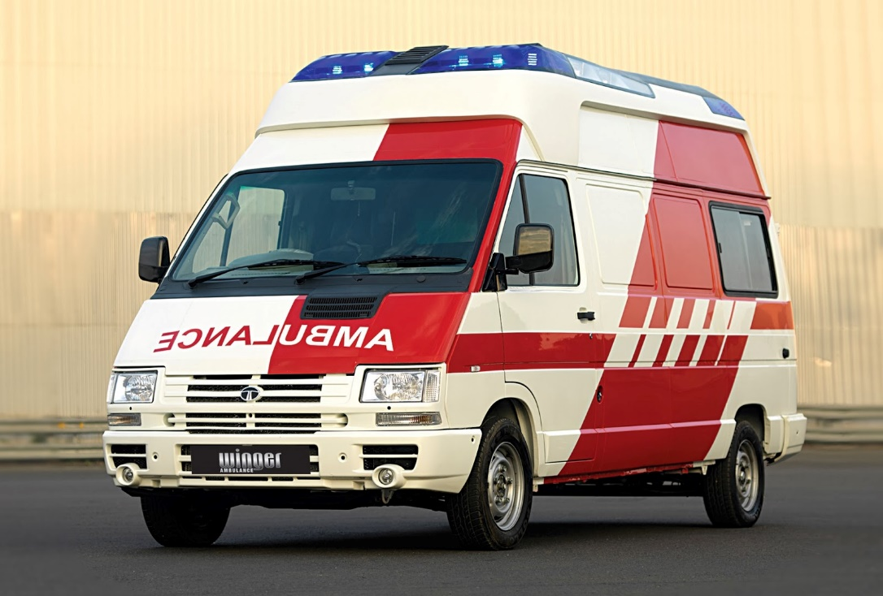
Bonus Marks
Why is the word ‘AMBULANCE’ written right to left on the vehicle?
Boys’ Brigade 8th Petaling Jaya Fire & Rescue- Basic

Slide 11
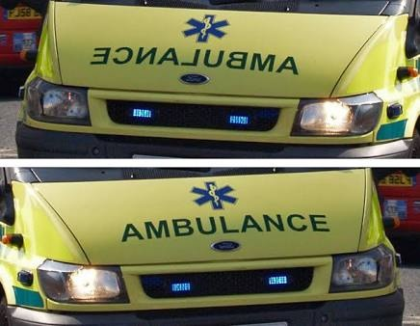
Bonus Marks
Thus, the word AMBULANCE is written laterally inverted in front of the ambulance because when seen in the rear view mirror by another vehicle, the image of the word would get inverted, letting the driver to read the word properly so that he can provide way to the ambulance
Boys’ Brigade 8th Petaling Jaya Fire & Rescue- Basic

