Slide 1
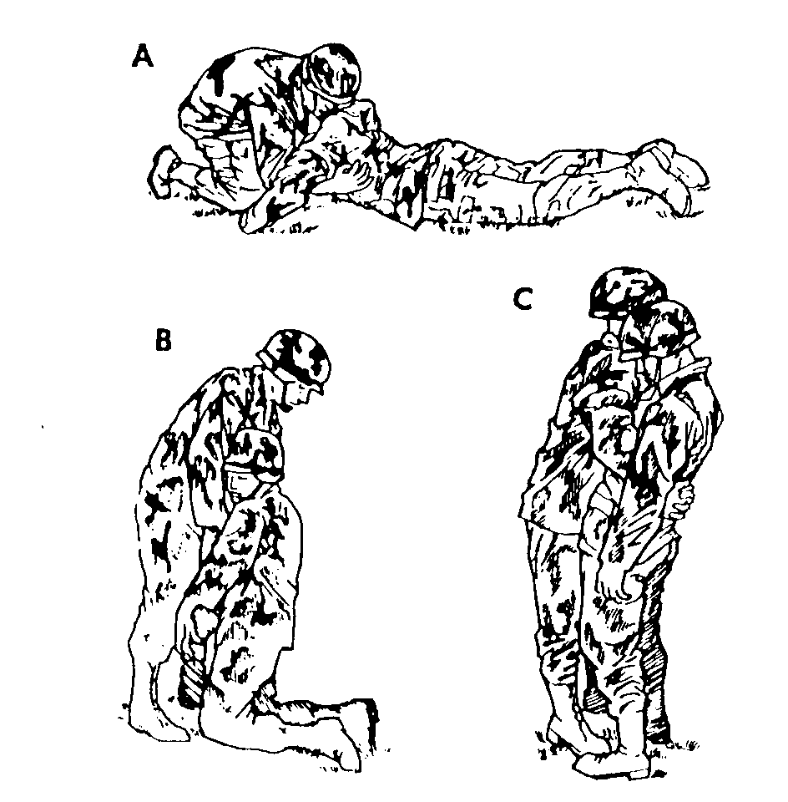
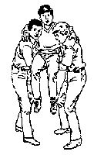
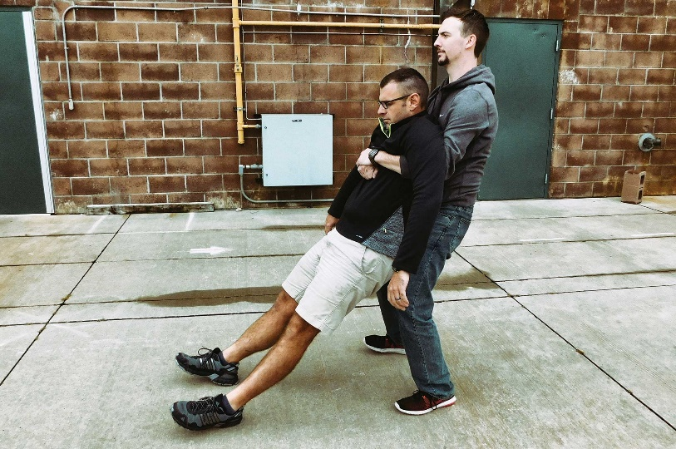
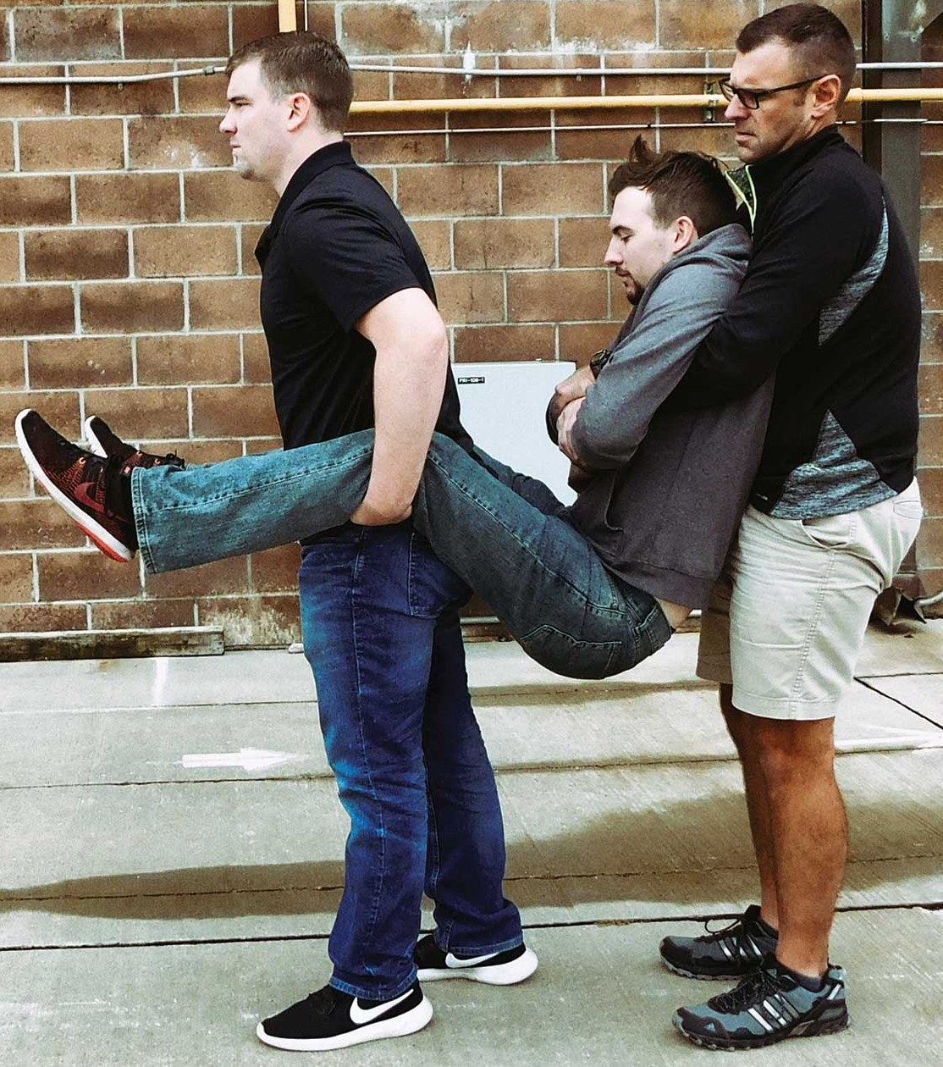
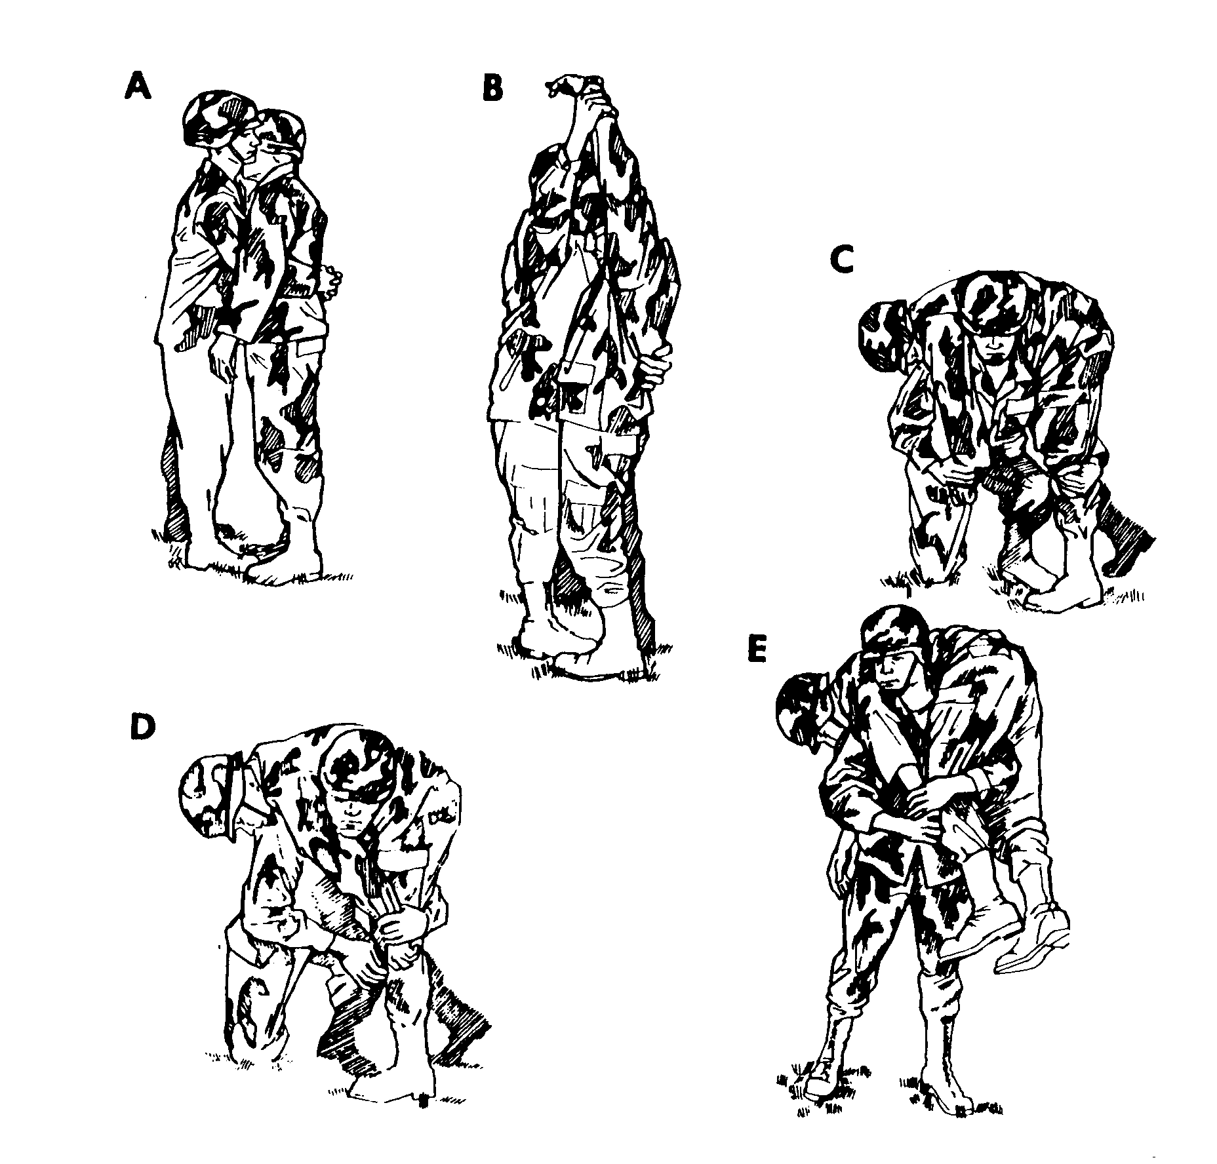
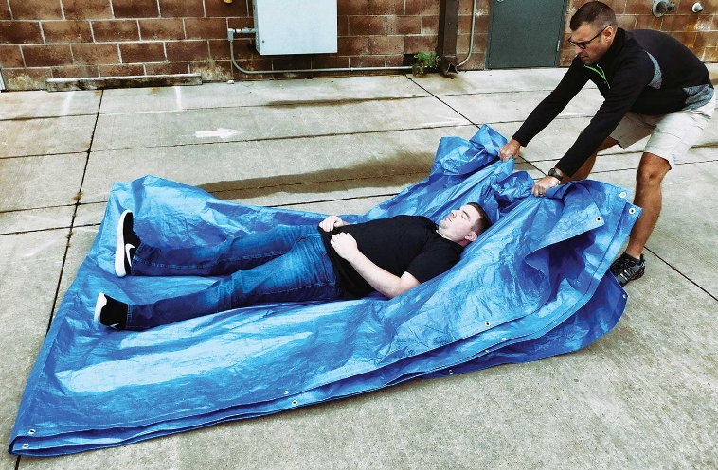
Week 5- Carrying Methods
Boys’ Brigade 8th Petaling Jaya Fire & Rescue- Basic

Slide 2
Objective(s)
What are Carrying Methods? Why?
Safety Concerns?
ON YOUR FEET!
Techniques & Applications
Boys’ Brigade 8th Petaling Jaya Fire & Rescue- Basic

Slide 3
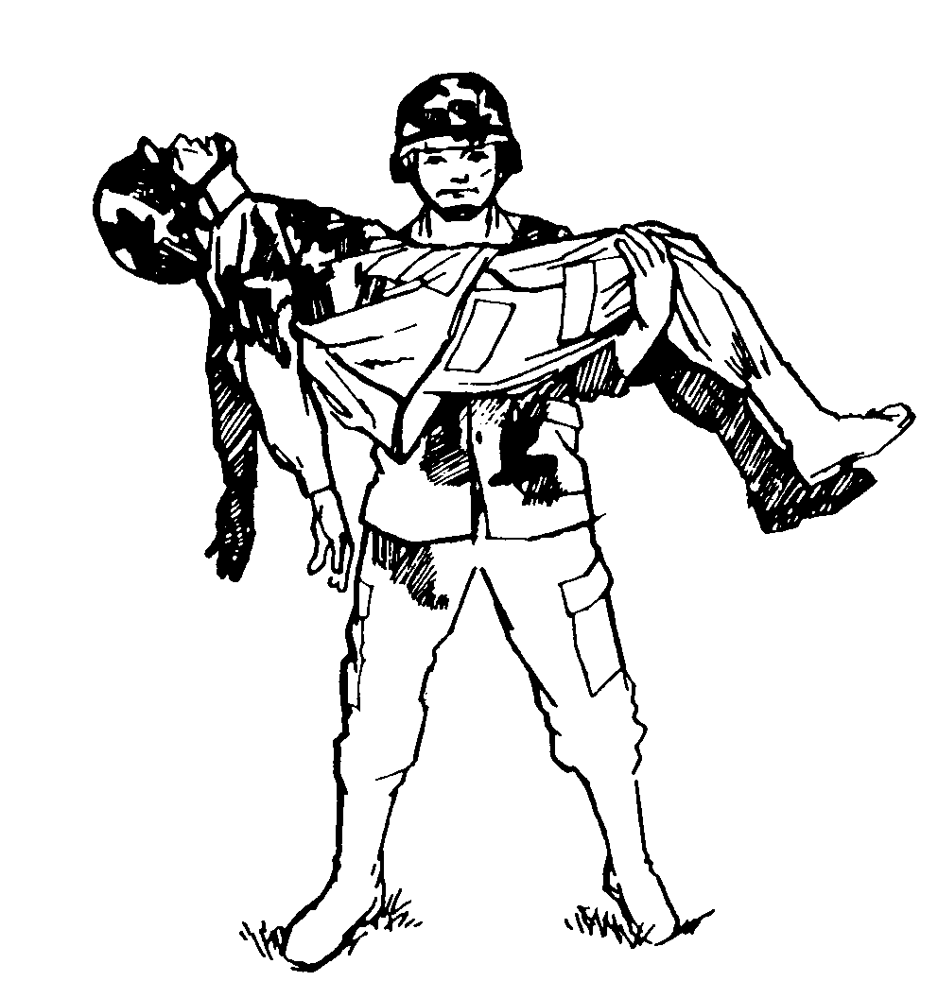
What are Carrying Methods
Relocating people away from precarious or deadly incidents.
Rarely, if ever, see someone carrying an adult victim out in front of them “cradle in arms” style. Why?
There are 2 categories of emergent victim removal; carries & drags
Victim Carries: When one or more rescuer is able to lift the victim and carry them to a location of safety.
Victim Drags: The movement of a victim by lifting part of their body as the other part drags — often used when a carry isn’t possible or practical.
Additional reads: https://bit.ly/2TGtQy7
Boys’ Brigade 8th Petaling Jaya Fire & Rescue- Basic

Slide 4
Safety Concerns?
Remember to keep your own safety a high priority!
If victim is conscious sustaining injuries, may cause them to shift their weight around when moving. Unfavourable scenario while moving them.
If victim is unconscious, they create deadweight and unable to assist you in any way by your extraction.
Relocating a victim will depend on several factors depending on victim injury:-
- How many victims are in need of rescue?
- How many rescuers are available?
- What are the capabilities and conditions of the rescuers?
- What is the size and condition of the victim(s)?
- What is the safety and stability of the environment?
Boys’ Brigade 8th Petaling Jaya Fire & Rescue- Basic

Slide 5
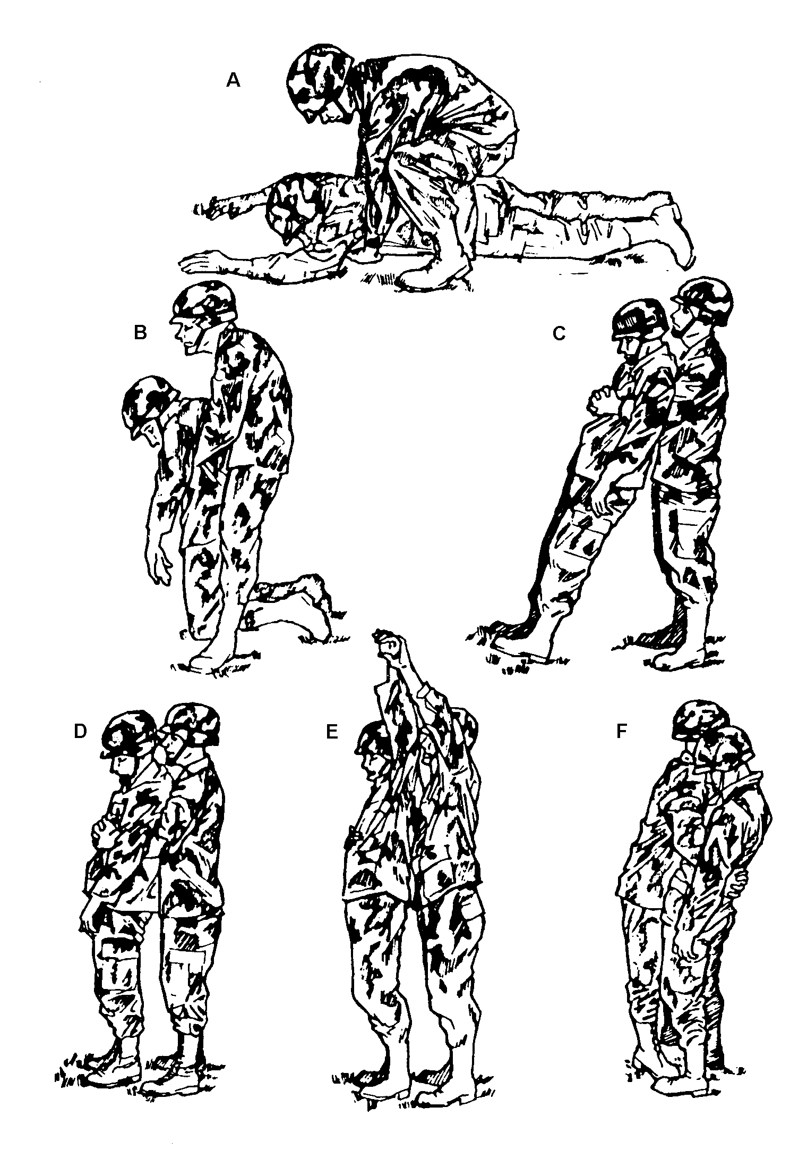
ON YOUR FEET!
OR
Additional reads: https://bit.ly/2XWUrWd
Boys’ Brigade 8th Petaling Jaya Fire & Rescue- Basic

Slide 6
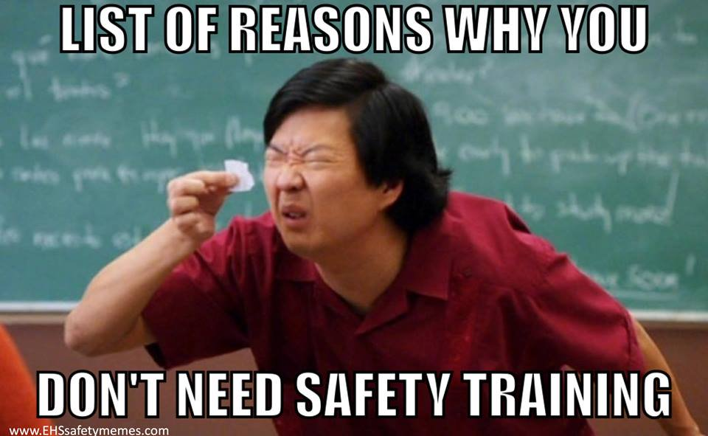
Techniques
Fireman’s Carry
Shoulder Drag
Two-Person Carries
Four-Hand Seat
Blanket Drag
Boys’ Brigade 8th Petaling Jaya Fire & Rescue- Basic

Slide 7
Fireman’s Carry
Carrying a victim longer distances. Difficult to get the person up to this position from the ground. The victim is carried over one shoulder.
Raise them to a standing position
Place your right leg between the victim’s legs
Grab the victim’s right hand with your left
Squat and wrap your right arm around the victim’s right knee
NOTE: Move your legs FIRST before your back!
Additional reads: https://bit.ly/2XWUrWd
Boys’ Brigade 8th Petaling Jaya Fire & Rescue- Basic

Slide 8
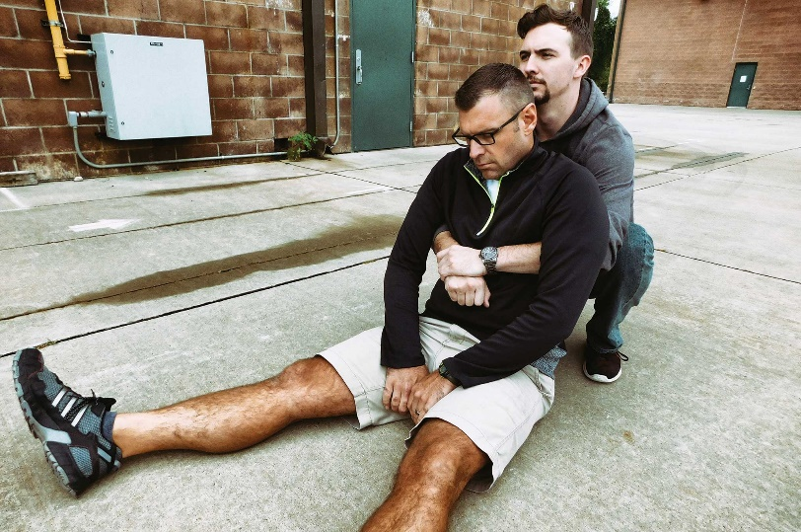
Shoulder Drag
The shoulder drag is another emergent maneuver for when a person needs to be moved quickly. This drag is difficult to perform over long distances as it’s physically taxing on the rescuer.
Place victim in a seated position
Squat behind the victim and reach under their arms
Grasping your own wrist
Stand, lean back, and walk backward dragging the victim to safety
Additional reads: https://bit.ly/2TGtQy7
Boys’ Brigade 8th Petaling Jaya Fire & Rescue- Basic

Slide 9
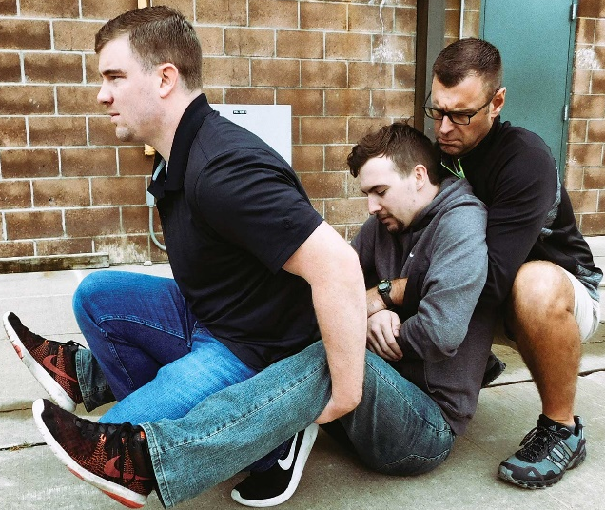
Two-Person Carries
The most safe and efficient way carrying a victim with two rescuers. The rescuers can share the weight, help each other watch for hazards, and work together efficiently without crowding too many people around the victim.
Help the victim to a seated position.
First rescuer reaches under their arms, and grabs their wrists.
Second rescuer backs between the victim’s legs, squats down, and grabs behind the knees.
Stand at the command of the rescuer at the head.
Focusing on using your legs rather than your back.
Additional reads: https://bit.ly/2TGtQy7
Boys’ Brigade 8th Petaling Jaya Fire & Rescue- Basic

Slide 10
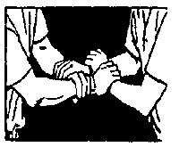
Four-Hand Seat
This technique is for carrying conscious and alert victims. The victim must be able to stand unsupported and hold themselves upright during transport.
Position the hands as indicated in the graphic.
Lower the seat and allow the victim to sit.
Lower the seat using your legs, not your back.
When the victim is in place, stand using your legs, keeping your back straight.
Additional reads: https://bit.ly/2Tbv3IE
Boys’ Brigade 8th Petaling Jaya Fire & Rescue- Basic

Slide 11
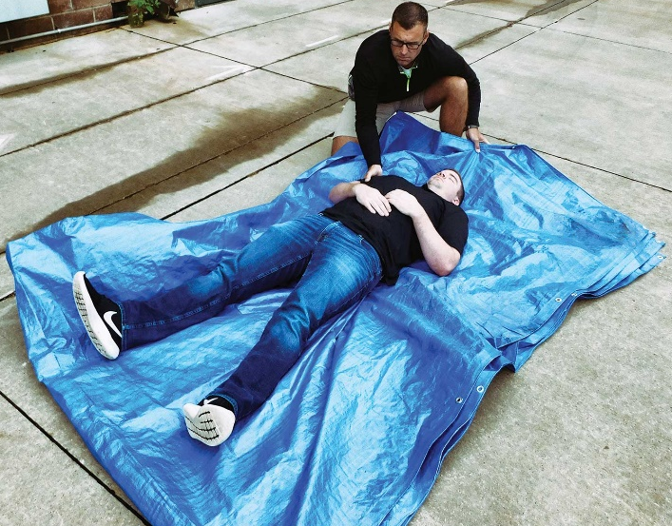
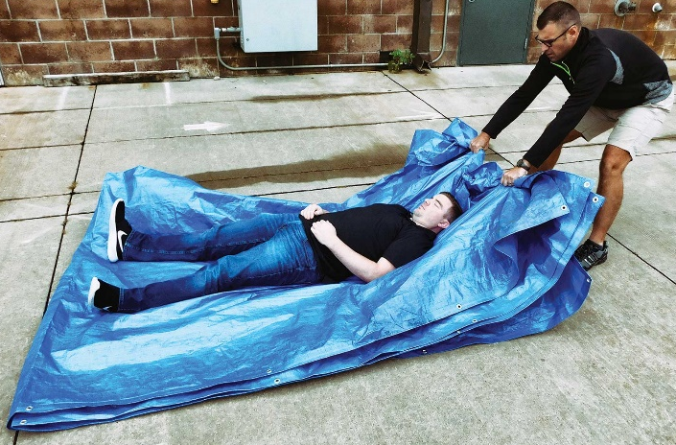
Blanket Drag/ Improvised Stretcher
The blanket drag/ improvised stretcher can be performed with a blanket, or a sheet, curtains, towel, tarp, or anything else that’ll accomplish the same goal with material to withstand weightage.
1) Tuck the blanket under one side of the victim
2) Roll the victim onto the blanket
3) Adjust the blanket so the victim is centered
4) Grab the blanket by the end near the victim’s head and drag to safety
Additional reads: https://bit.ly/2TGtQy7
Boys’ Brigade 8th Petaling Jaya Fire & Rescue- Basic

